Slide 1


By-Shrishti Jain

Slide 2

Footprinting has 3 basic and 7 advanced steps.
Basic steps-
1.Using social networking sites
2.Using hacking search engines
3.Using advanced search components of google

Slide 3

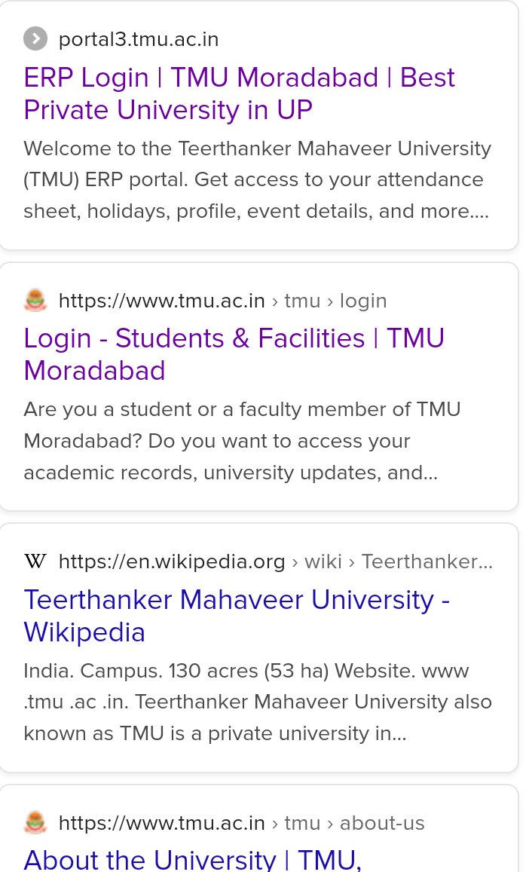


Slide 4

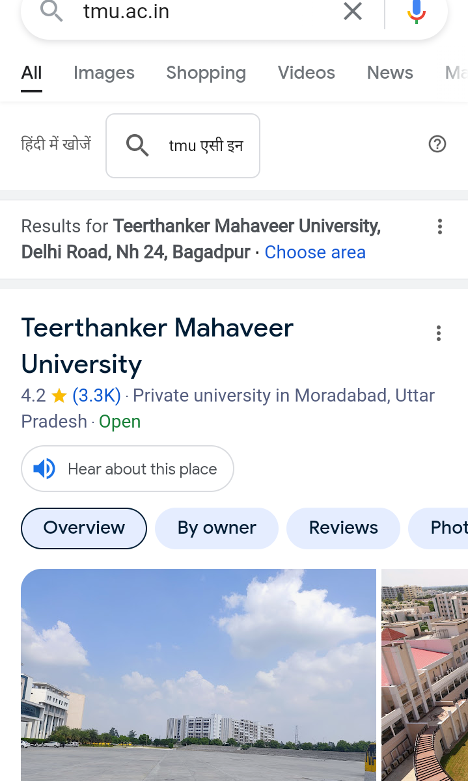

Slide 5





Slide 6
Advanced steps-
1.Knowing website technology
2.Find subdomain of target
3.Find all links of a website
4.Find buffersize of website
5.SSl test
6.Time travel on website
7.Find security headers of a website

Slide 7
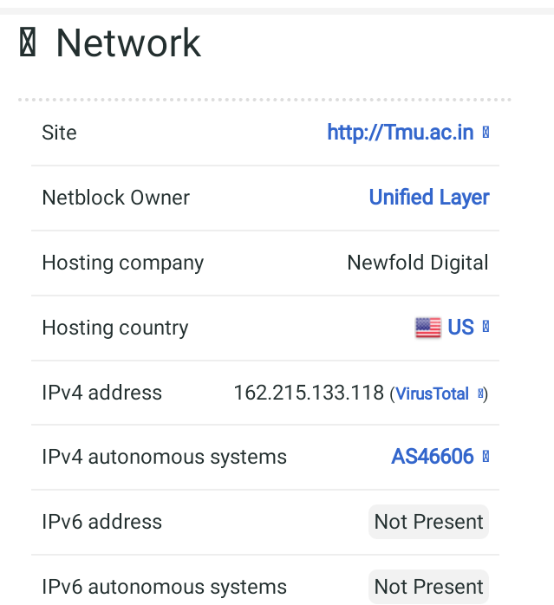

Slide 8
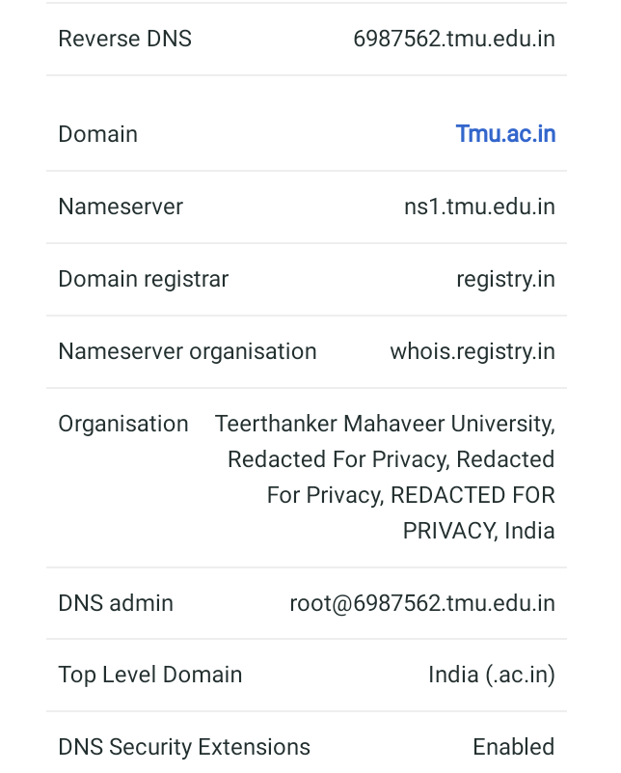

Slide 9
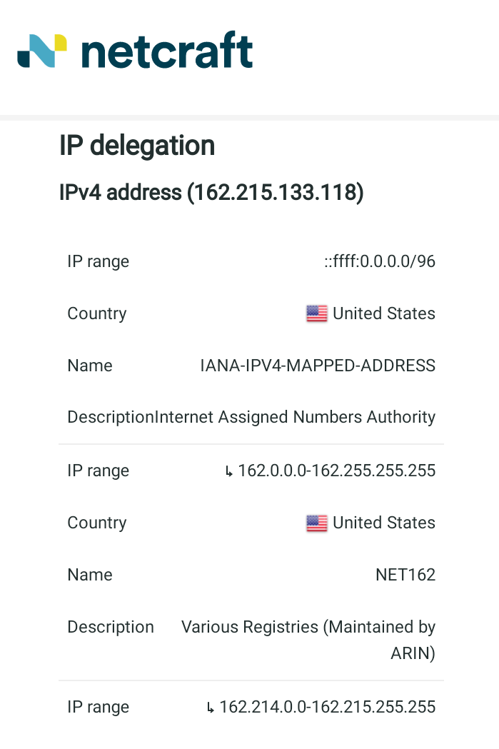

Slide 10
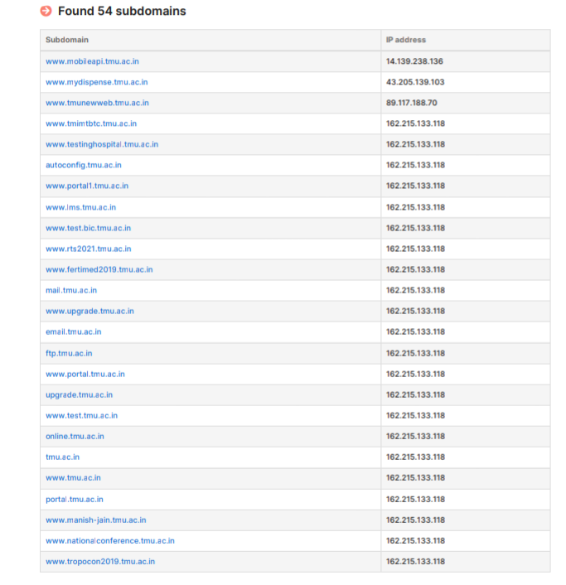

Slide 11
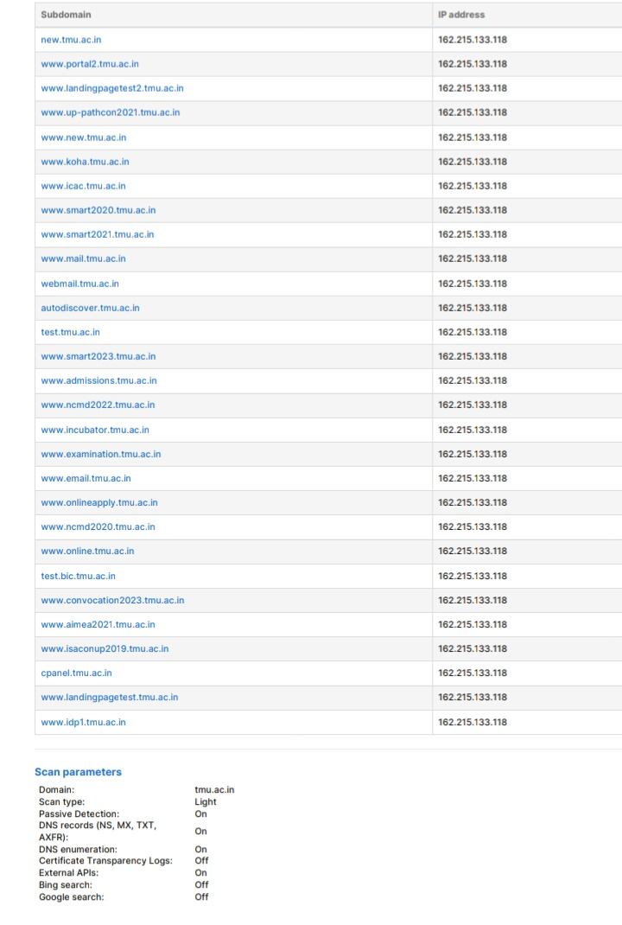

Slide 12


Slide 13
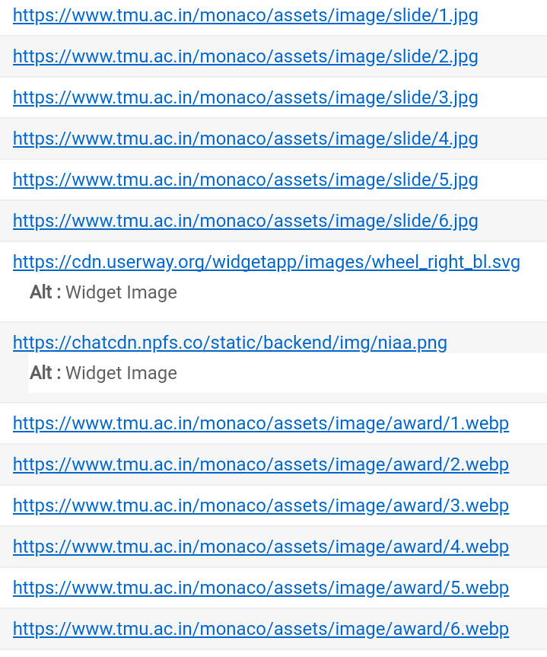

Slide 14
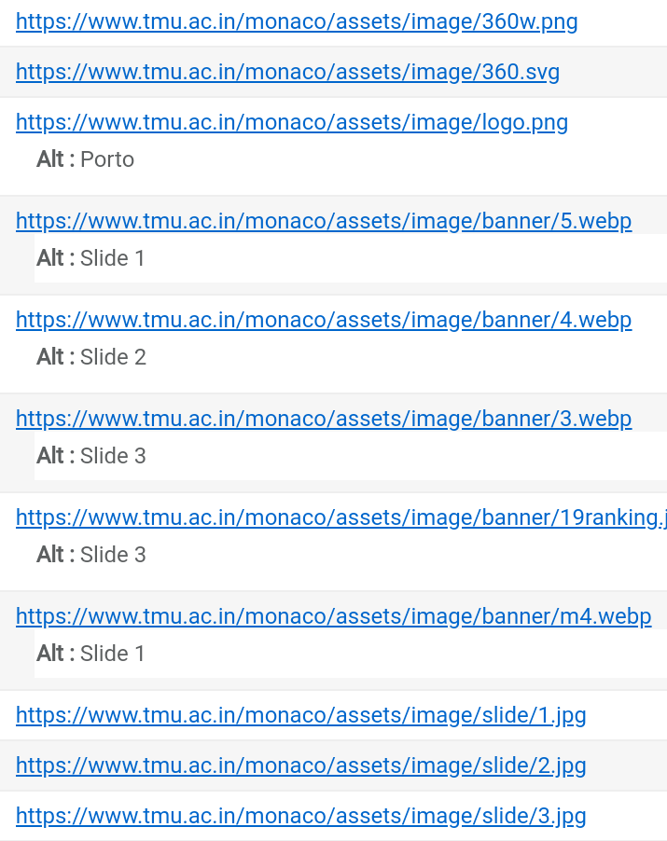
Buffer size of tmu.ac.in -1470 bytes

Slide 15
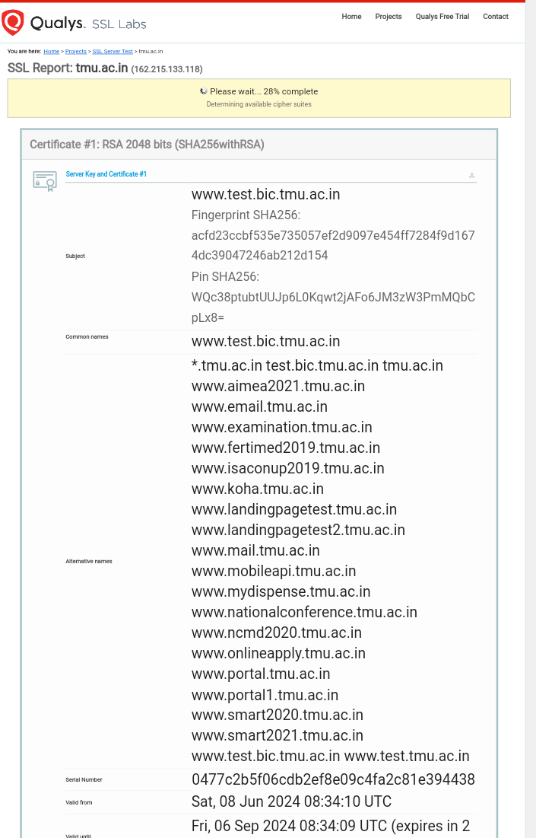

Slide 16
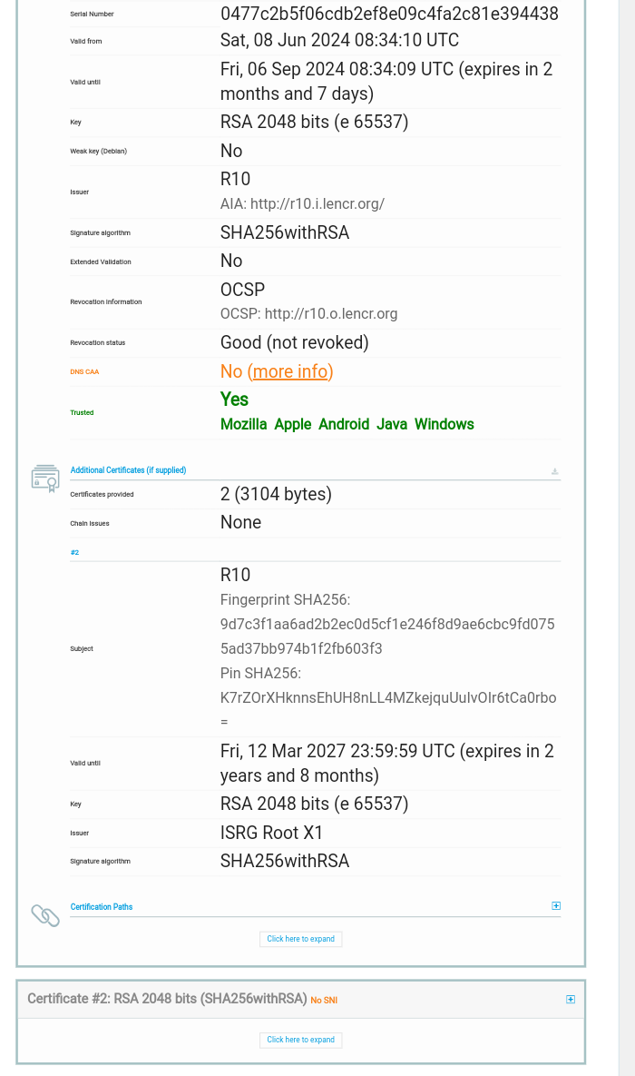

Slide 17




Slide 18
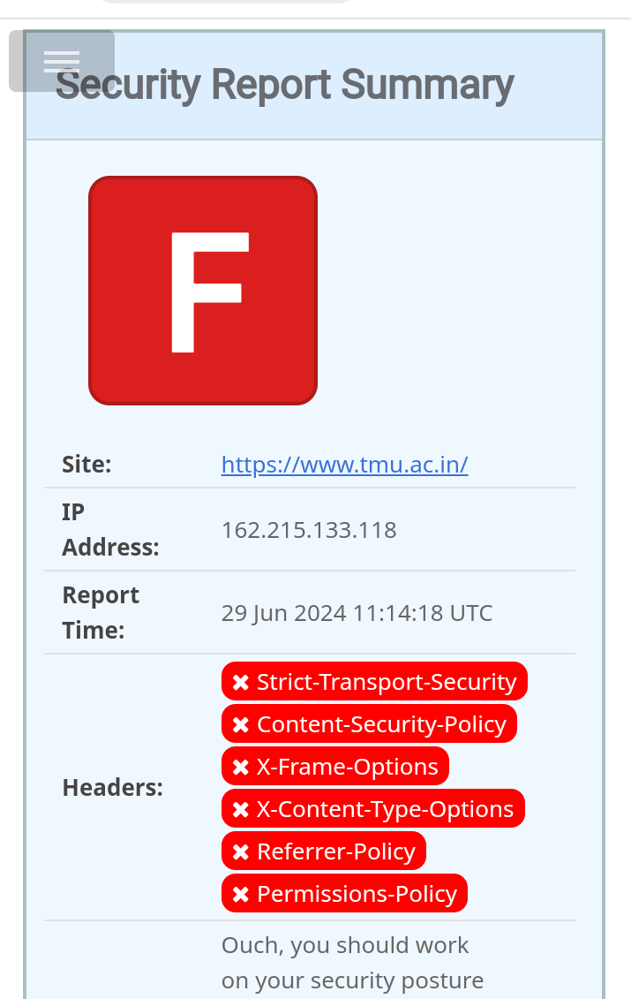

Slide 19
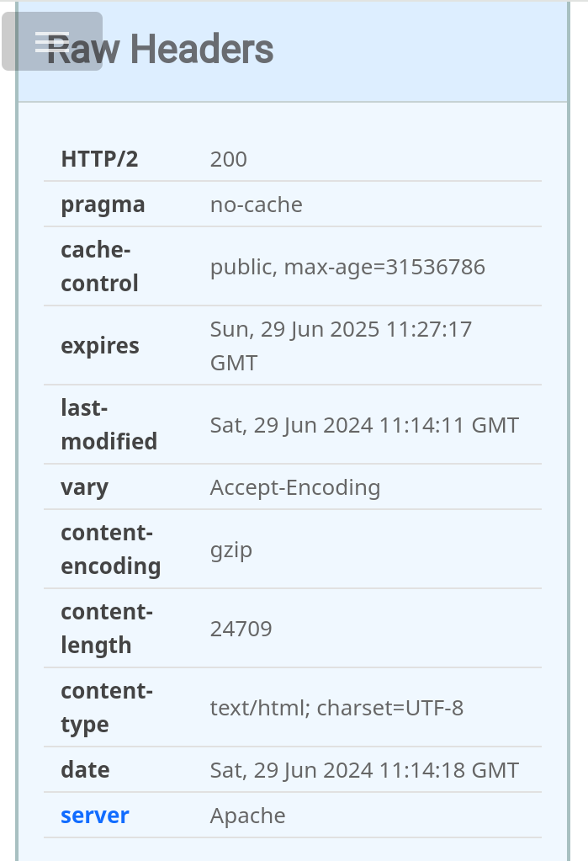
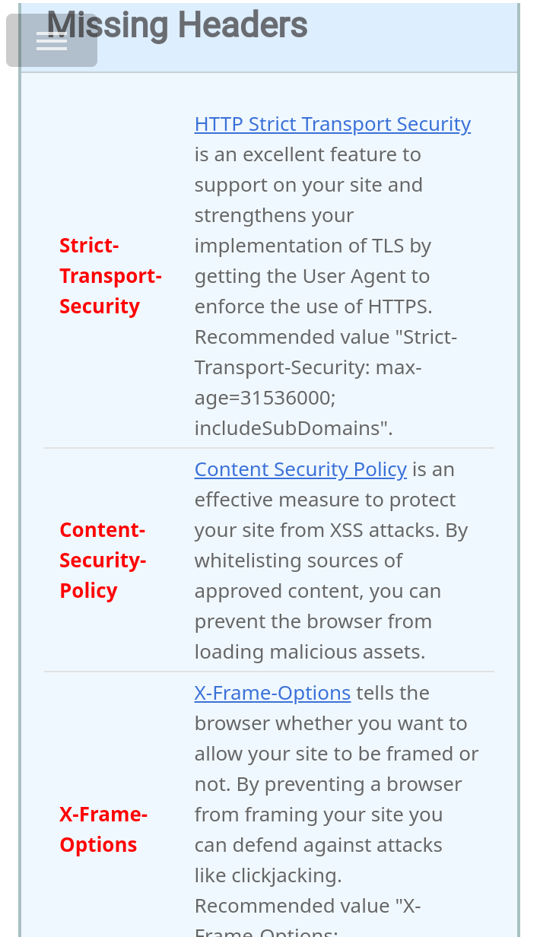

Slide 20


